Slide 1
CDL Architecture
August 4, 2020
Evanston | +1 847 492 3600

Slide 2

























Solution Architecture
Analytics
Offline Reporting (VM)
HQ
Analysts
Data Sources
LANDING LAYER
Commercial Data Lake
AWS S3
CDL ZONES
RAW LAYER
REFINED LAYER
STANDARDIZATION ZONE
WORK LAYER
CONSUMPTION Layer
Abstraction Layer
Base Layer (by Th. Area)
Re-usable Modules
Ambassador
Epsilon
Opus
Quintiles (IMS)
Pharm Soln. (SP)
SHS (integrated)
ZS (NPA/NSP)
MMIT
Deliverables Databases
(by Th. Areas)
Payer Stencils
DQM
COLLAB. ZONE
Configurations (by Th. Area)
Pat Serv. Stencils
Hist. Layer (by Th. Area)
PLD Stencils
Collab.Wksp
(by Th. Areas)
SQOOP
AbbVie Teradata
(DSL, SMDW, CMDW)
Alignment, Placement, Activity, Product, ..
Config Mgmt.
Portal (HQ/Analysts)
Security
Kerberos
Orchestration & Logging

Slide 3
CDL Zones
CDL zones are logical partitioning of the HDFS storage within AbbVie Data Lake based upon the different business areas. Below are the different zones available in CDL
CDLS (Commercial Data Lake syndicated)
CDLH (Commercial Data Lake HCP 360)
CDLMA (Commercial Data Lake Market Access)
It has the syndicated data where ID’s (ex: Patient ID) are masked.
This zone stores data related to Physician. It contains sales, alignment, call planning datasets
This zone holds claims related data like rebates and copay. It gives information like how copay card is being used, what rebates have AbbVie paid for the prescription etc.
CDLM (Commercial Data Lake Marketing)
CDLO (Commercial Data Lake Operations)
CDLHO (Commercial Data Lake HCP Operations)
This zone stores Patient related data like copay claims, nurse ambassador, patient services, patient support, CRM data etc.
This zone contains Clickstream data from different websites for all therapeutic areas. It also stores accredo and Cigna datasets
This CDL zone is a secure CDL zone and holds the Incentives information and HQ Reports of AbbVie Field Force. It also holds the incentive information which is consumed by UXT team.
This is an evolving platform and new zones are added in the CDL

Slide 4
ETL & Storage Layers
Every CDL zone has the following storage layers
Landing Layer
Raw Layer
Refined Layer
This is an AWS storage area, all the source files which needs to be ingested are made available in this layer.
This is an HDFS storage area, raw tables are created to load the source files as they are received. This is an truncate and load layer
This is an HDFS storage zone, refined tables are created in this zone with appropriate data types and DQM rules are applied on source data. This is an truncate and load layer
Work Layer
Consumption Layer
This is an HDFS storage zone where data transformation and load is performed. All business rules and logic are applied at this layer. This layer also has re-usable modules which can be utilized for the data transformation purpose. Incremental data is loaded and maintained in this layer.
Datasets in this layer are made available for downstream consumption. Views/tables are created in this layer based on the project requirements.

Slide 5

Tools used across Data Lake
Scripting
SQL/Analytics
Orchestration
Python
HUE
Autosys
Pyspark
Jupyter Notebook
Hive/ Impala /
Pyspark shell
Shell scripting

Slide 6
Appendix

Slide 7
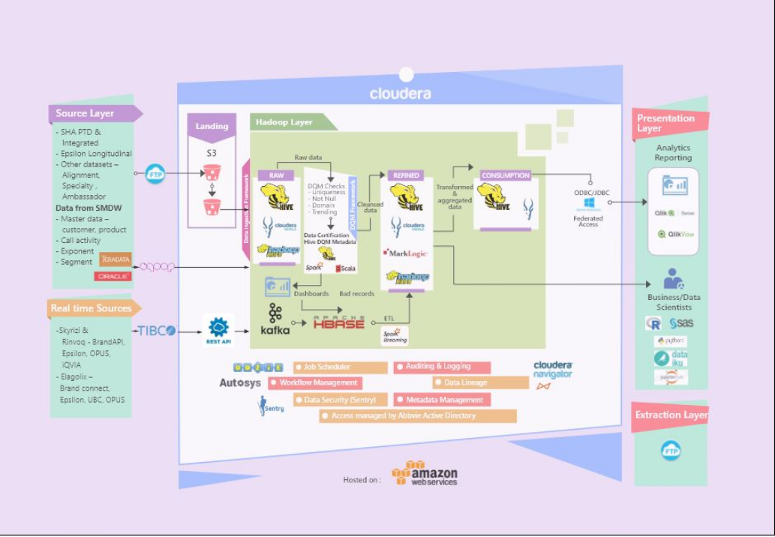
CDL Architecture

